Slide 1
Drink and Delight
Inventory management software

Slide 2
Scrum development team
Atal Kumar (Scrum Master)
Ayushi Goyal
Harshit Verma
Mukul Garg
Mohit Kumar

Slide 3
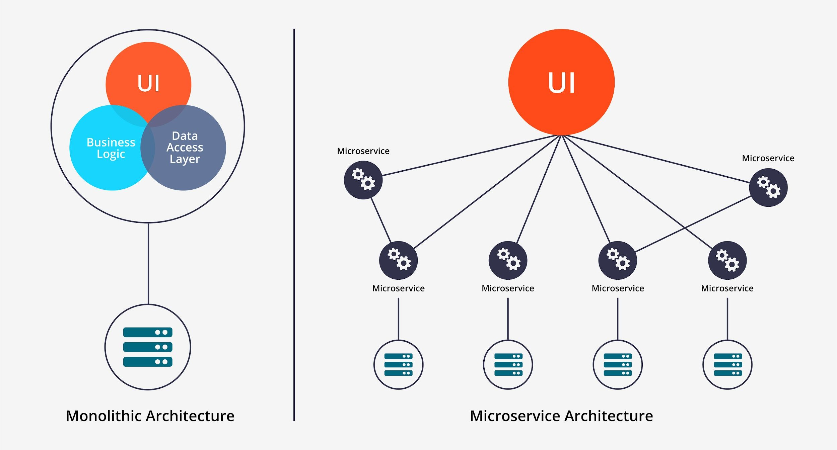
Architecture Design

Slide 4
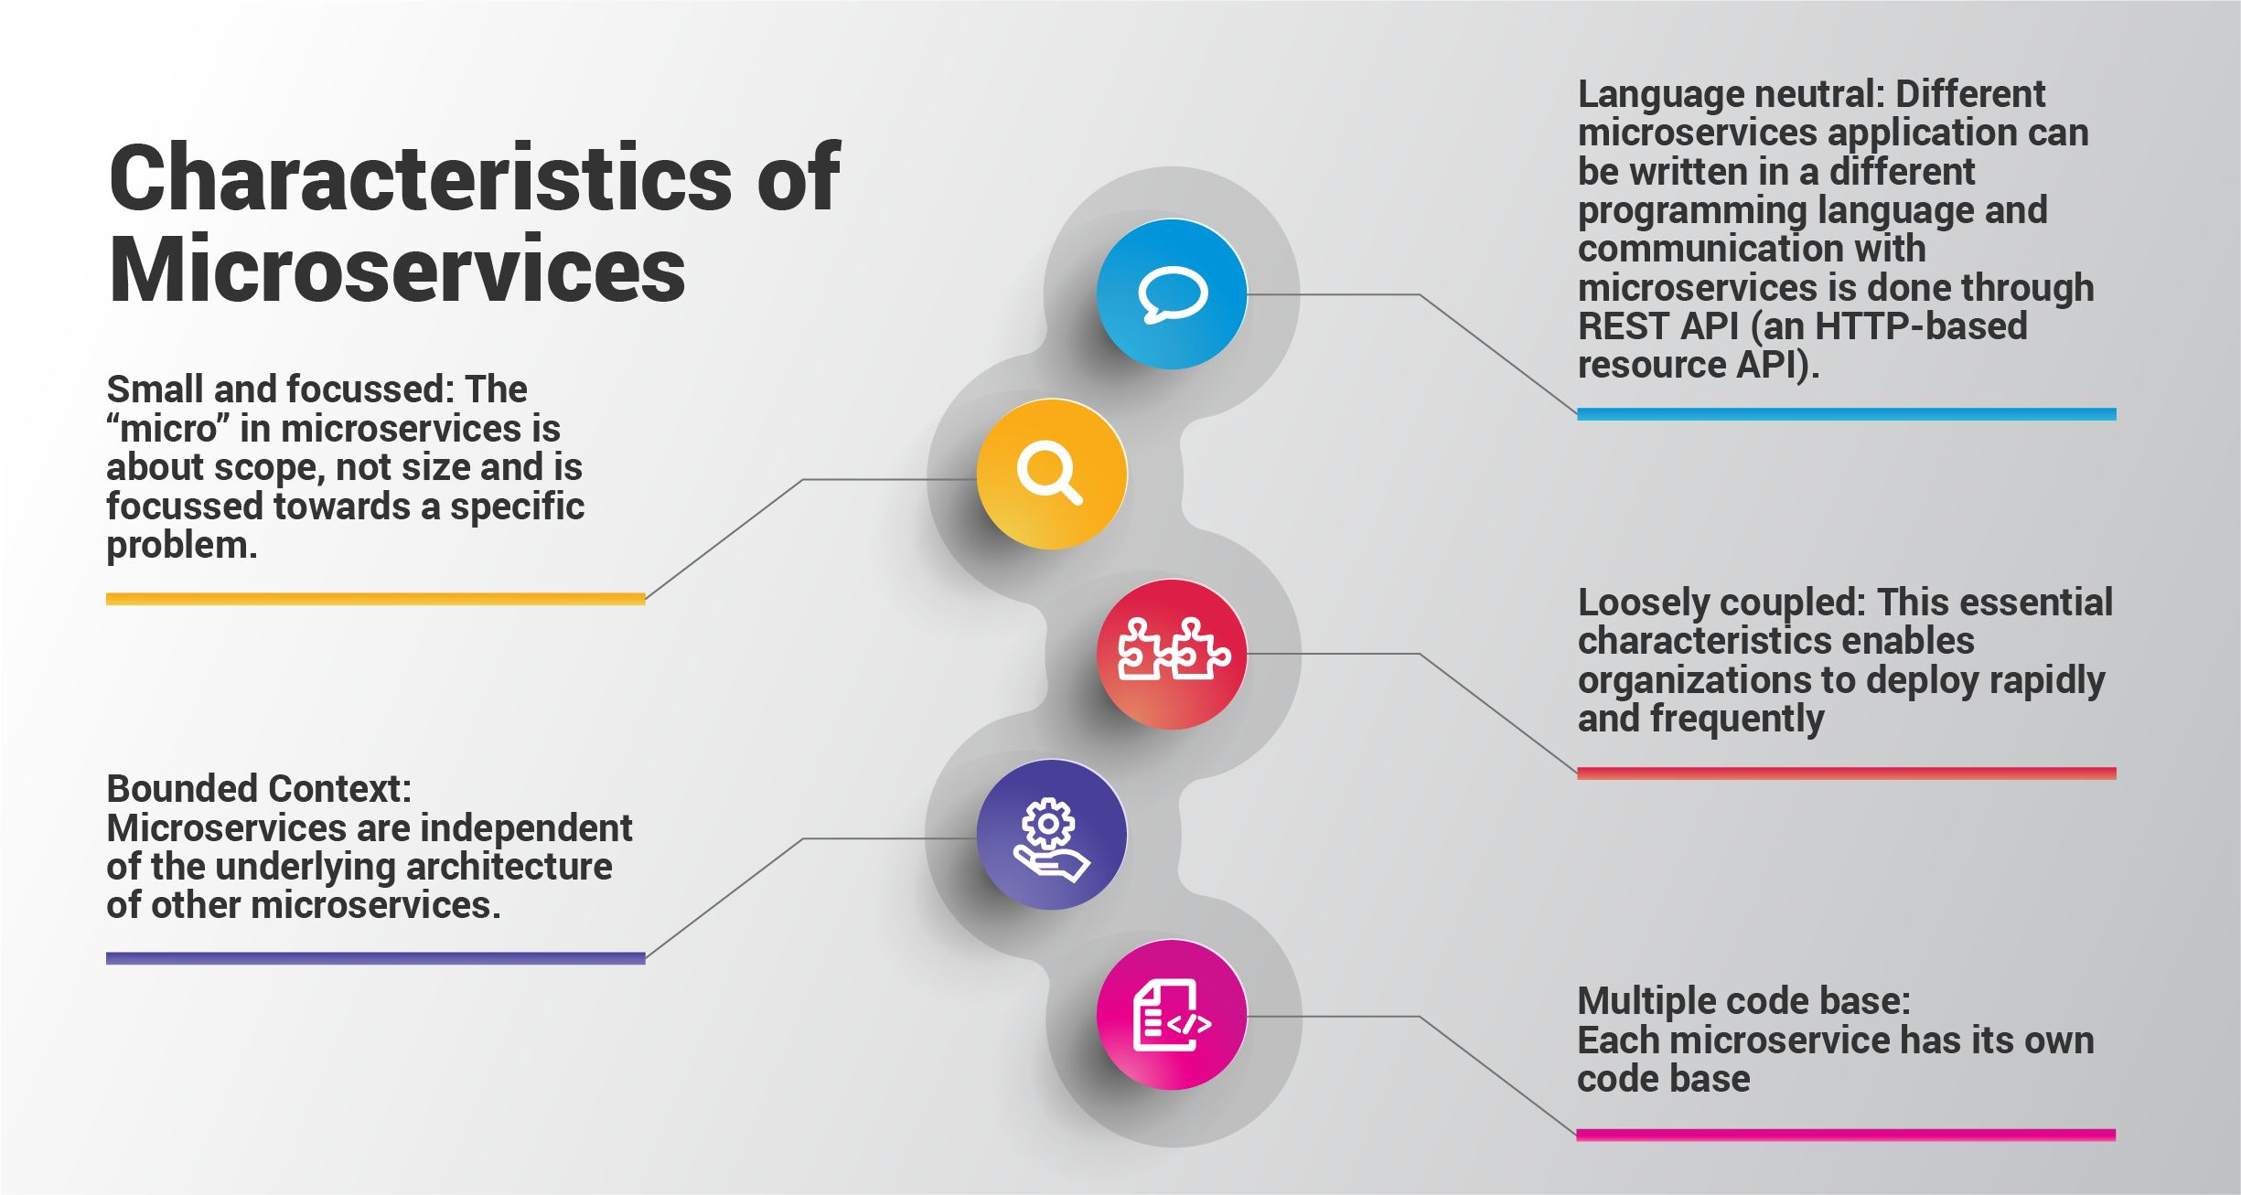

Slide 5

Framework in use

Slide 6
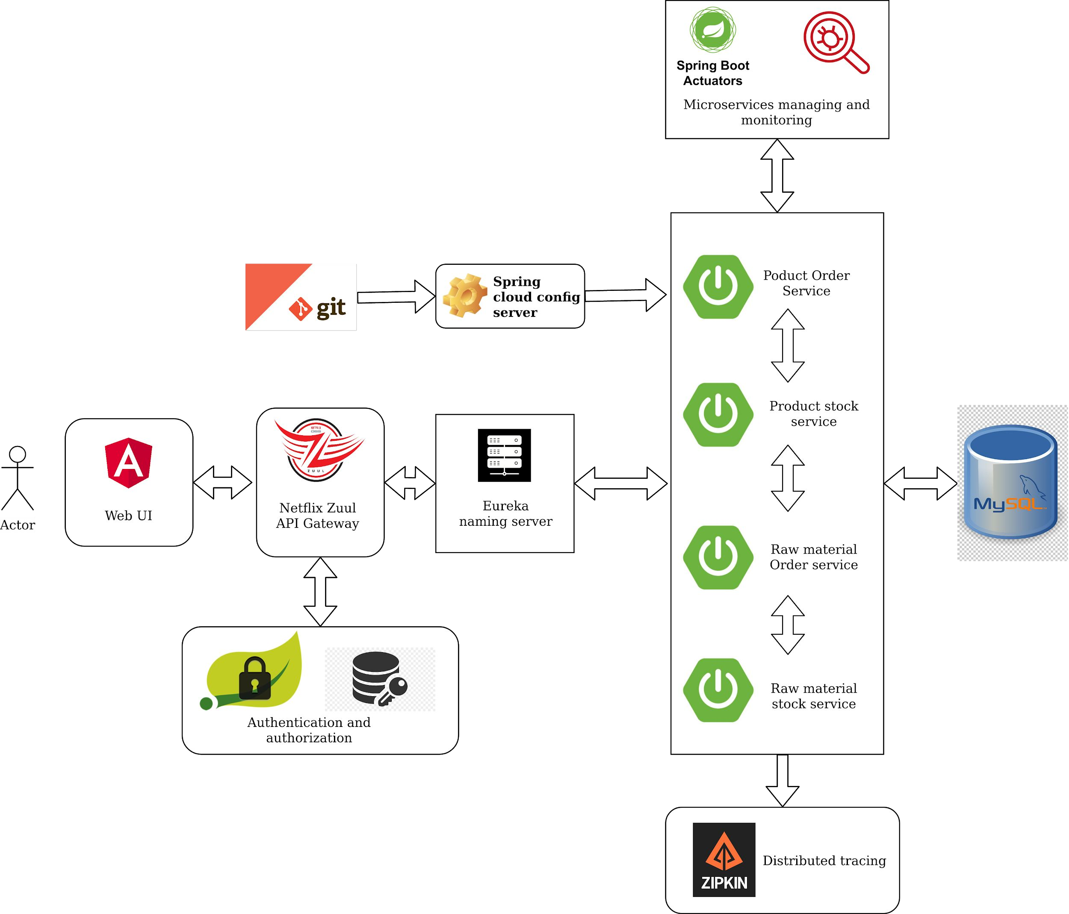
Project Architecture

Slide 7
Project Flow

Slide 8
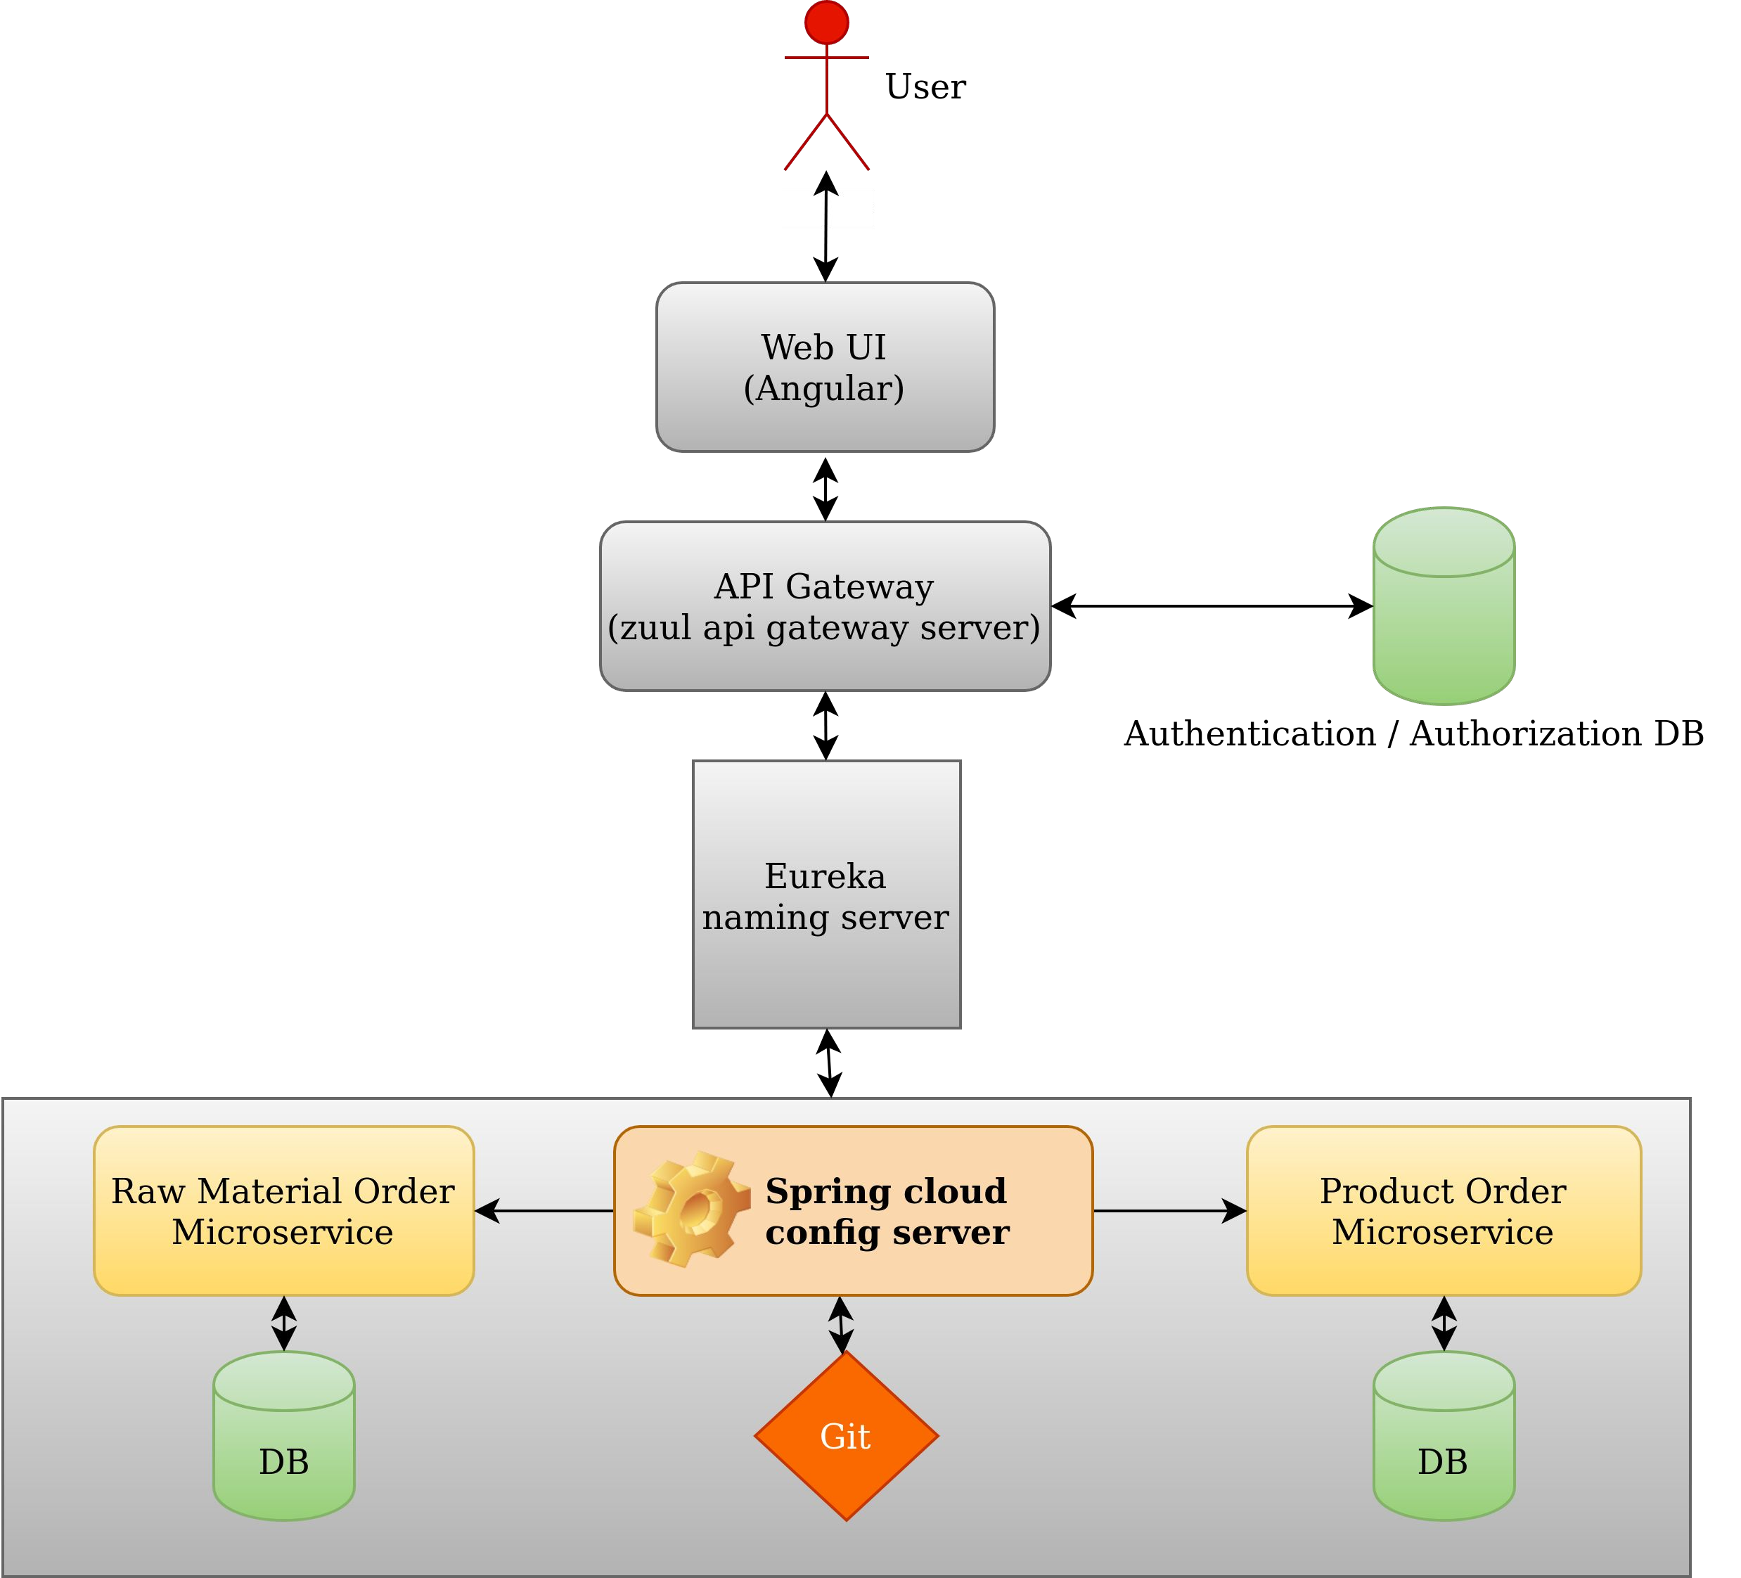
Order Management Flow

Slide 9
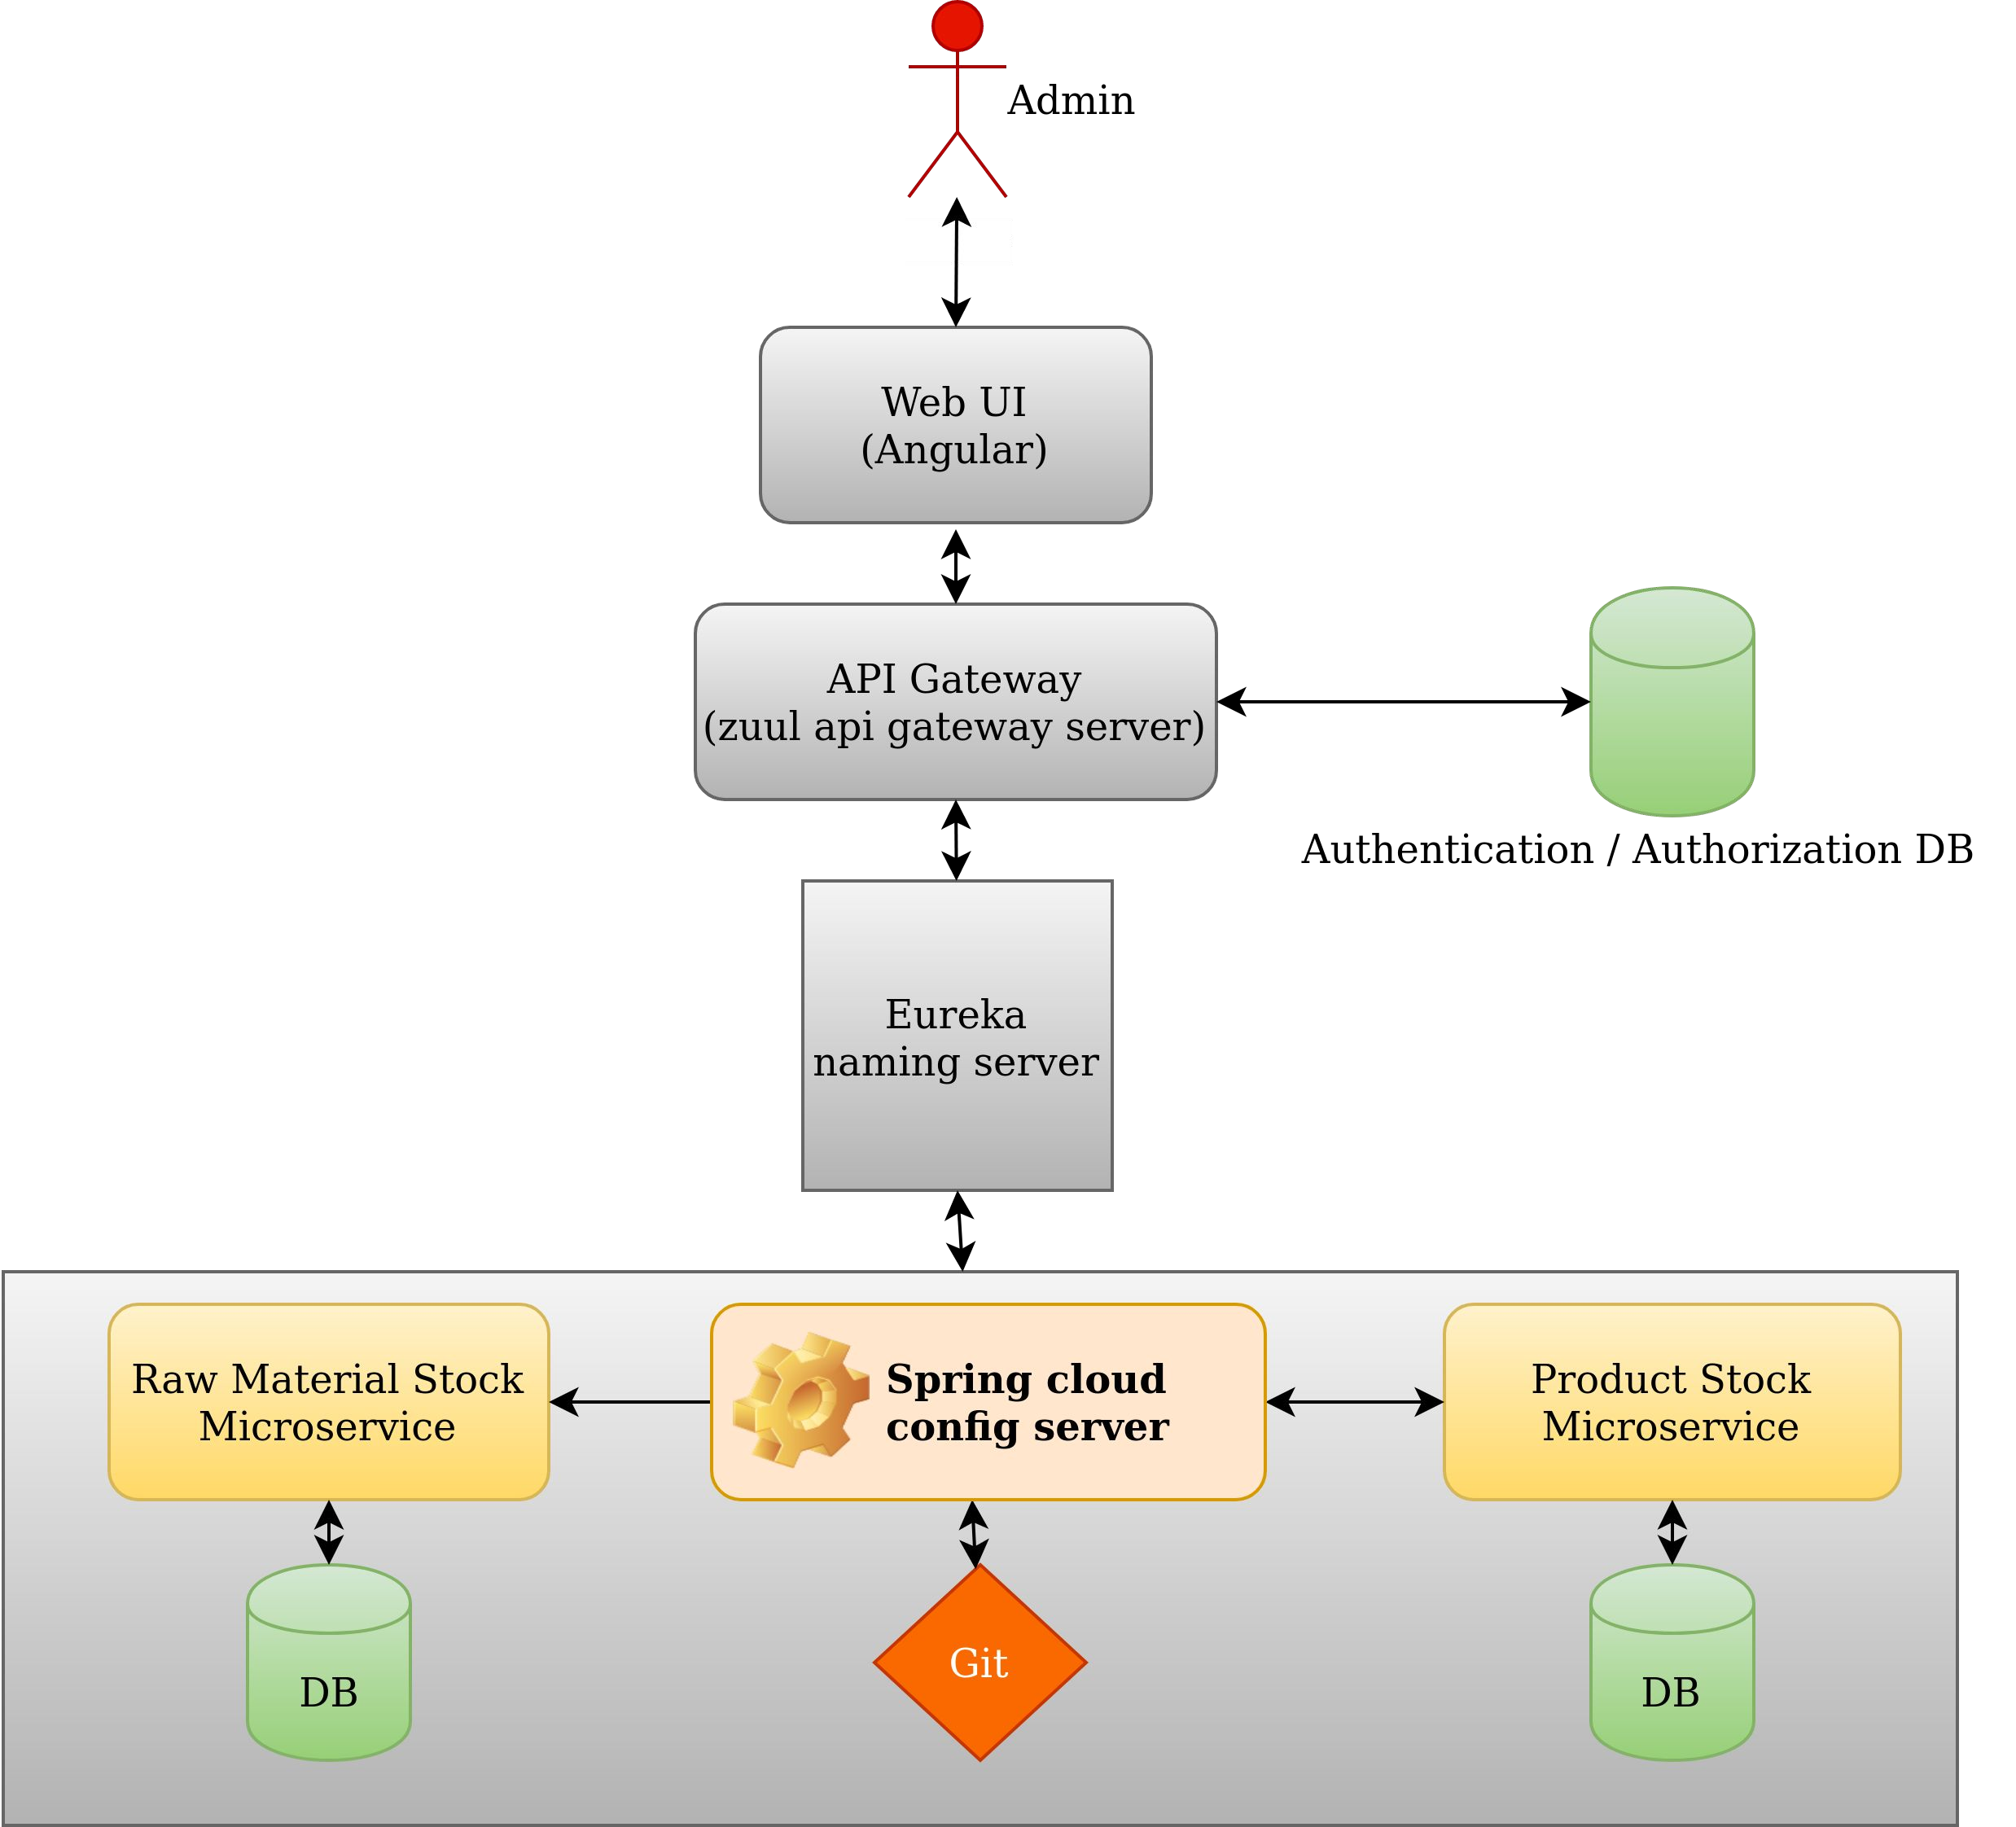
Stock Management Flow

Slide 10
Use Case Diagram

Slide 11
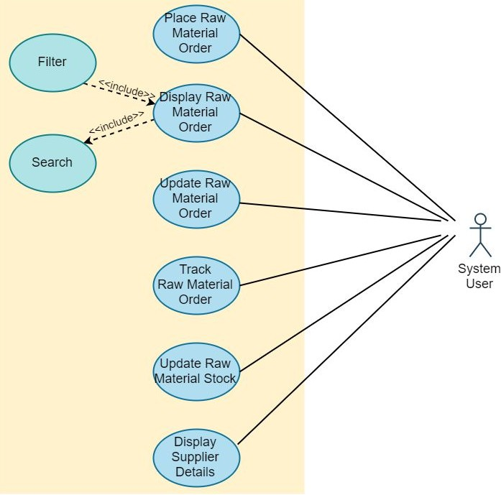
Raw Material

Slide 12
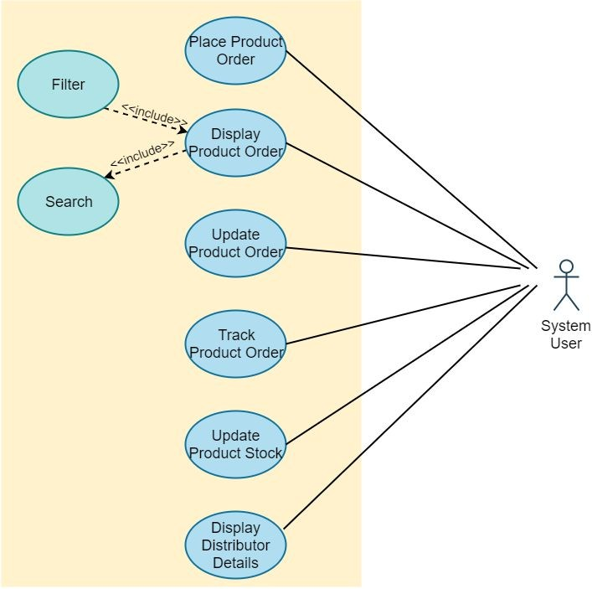
Product

Slide 13
Thank you

